Slide 1
Advanced Computer Vision
Chapter 12
3D Reconstruction
Presented：許展銘
授課教授：傅楸善
0987233003
r07945010@ntu.edu.tw

Slide 2
Before Start…
123D Catch for iOS 7
Capture: 3D Scan Anything
holoportation: virtual 3D teleportation in real-time

Slide 3
Ch12. 3D reconstruction
12.1 Shape from X
12.2 Active rangefinding
12.3 Surface representations
12.4 Point-based representations
12.5 Volumetric representations
12.6 Model-based reconstruction
12.7 Recovering texture maps and albedos

Slide 4
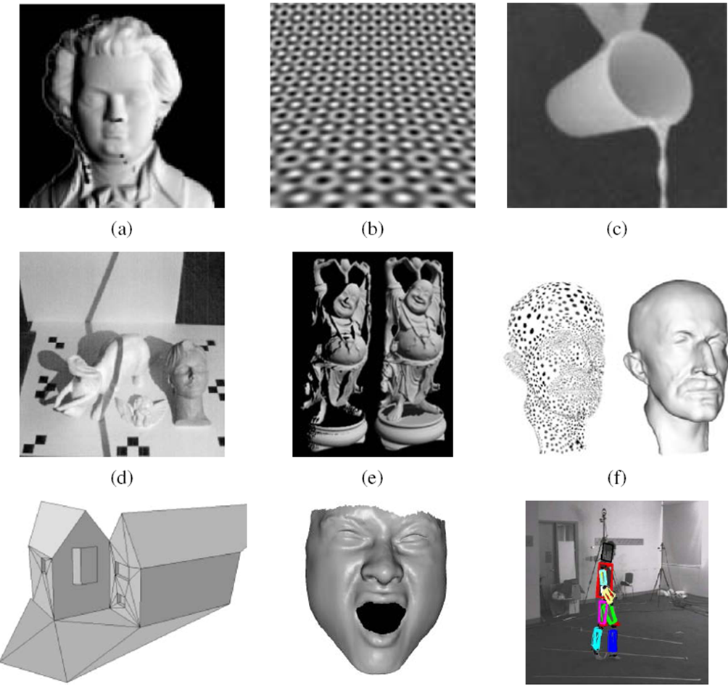
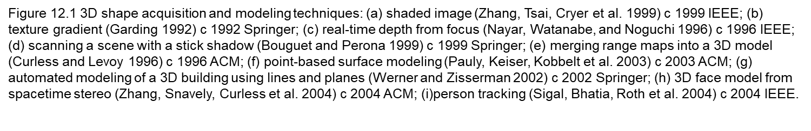

Slide 5
12.1 Shape from X
The study of how shape can be inferred from such cues like shading, texture, focus is sometimes called shape from X
Shape from shading
Shape from texture
Shape from focus

Slide 6
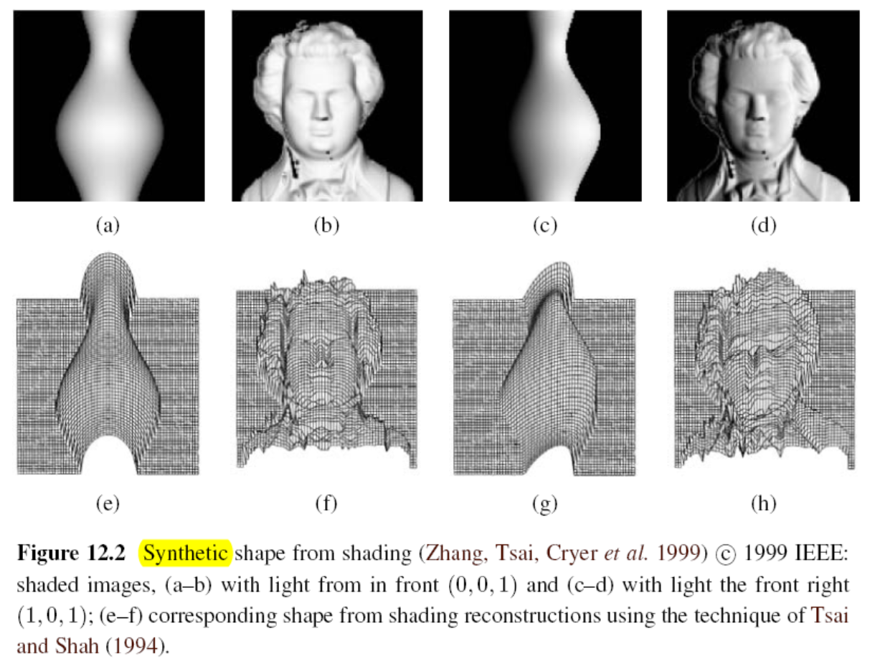
12.1.1 Shape from shading and photometric stereo

Slide 7
12.1.1 Shape from shading and photometric stereo
How is this possible?
The answer is that as the surface normal changes across the object, the apparent brightness changes as a function of the angle between the local surface orientation and the incident illumination.
shape from shading
The problem of recovering the shape of a surface from this intensity variation is known as shape from shading.
Notes:
陰影 跟 立體光學法
Surface 曲面法向量
Incident 入射光

Slide 8
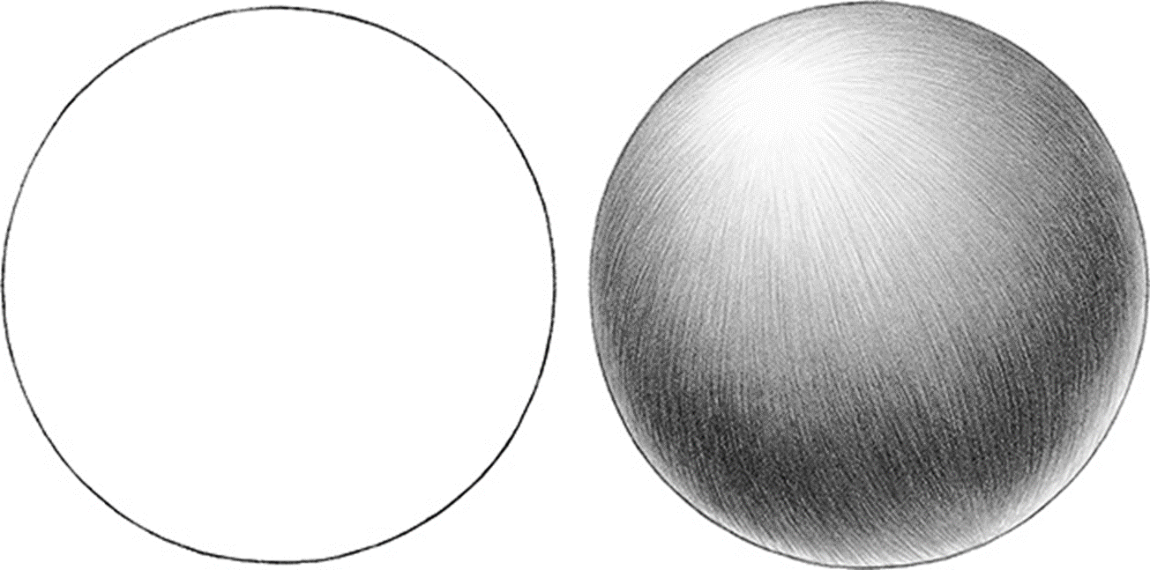

Slide 9
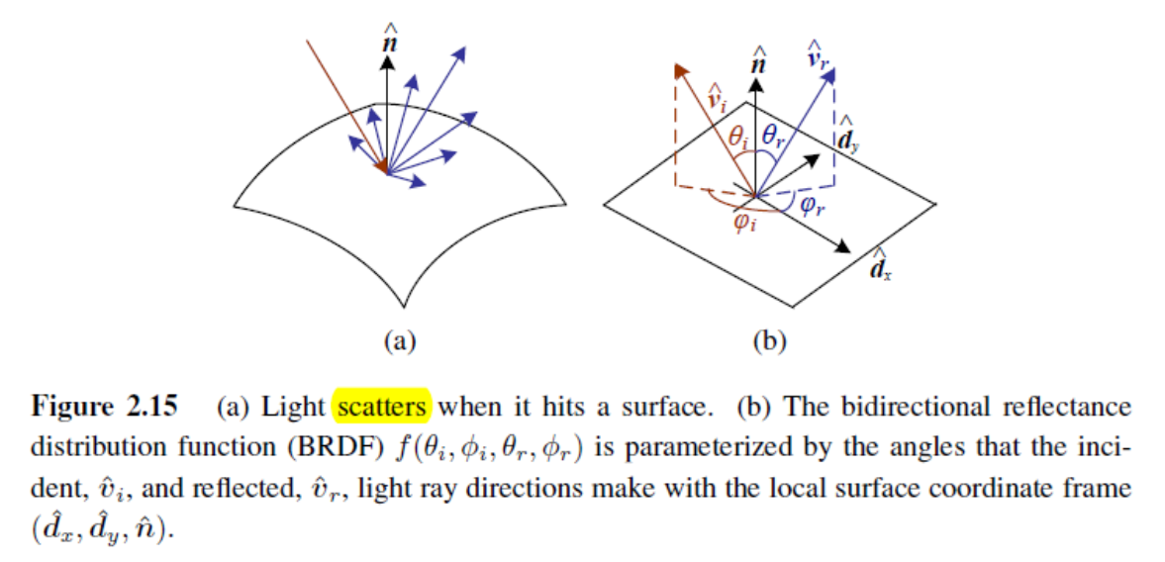
12.1.1 Shape from shading and photometric stereo
Notes:
雙向反射分布函數是一個定義光線在不透明表反射的四次元函數
這裡 是指光線反射的方向 跟 光線的反方向
可透過 方向角跟天頂角參數化

Slide 10
12.1.1 Shape from shading and photometric stereo
Most shape from shading algorithms assume that the surface under consideration is of a uniform albedo and reflectance, and that the light source directions are either known or can be calibrated by the use of a reference object.
The variation in intensity (irradiance equation) become purely a function of the local surface orientation,
I(x; y) = R(p(x; y); q(x; y));
where (p; q) = (z_{x}; z_{y}) are the depth map derivatives and R(p; q) is called the reflectance map.
Notes:
Albedos 反照率 漫反射或是表面反射的能力
calibrate 測量
irradiance equation 輻照度 落光
「直接輻照度」與「漫輻照度」的代數和
傾斜平面，還必需添加「反射輻照度」，即從地面反射出的輻照

Slide 11
12.1.1 Shape from shading and photometric stereo
For example, a diffuse (Lambertian) surface has a reflectance map that is the (non-negative) dot product between the surface normal:
and the light source direction:
reflectance map:
where is the surface reflectance factor (albedo)
Albedo: Reflection Coefficient

Slide 12
12.1.1 Shape from shading and photometric stereo
Lambertian Surface
Light falling on it is scattered such that the apparent brightness of the surface to an observer is the same regardless of the observer's angle of view.
Perfect Reflecting Diffuser
A Perfect (Reflecting) Diffuser (PRD) is a theoretical perfectly white surface with Lambertian Distance (its brightness appears the same from any angle of view). It does not absorb light, giving back 100% of the light it receives.
Notes:
朗伯表面具有以下兩種性質。第一、不論表面被光如何照射，在所有的觀測方向上都是呈現相
同輝度，即輝度是與方向無關的常數。第㆓、如果所有入射光都被反射，無任何吸收，則又稱為完
美反射漫射體(perfect reflecting diffuser)。

Slide 13
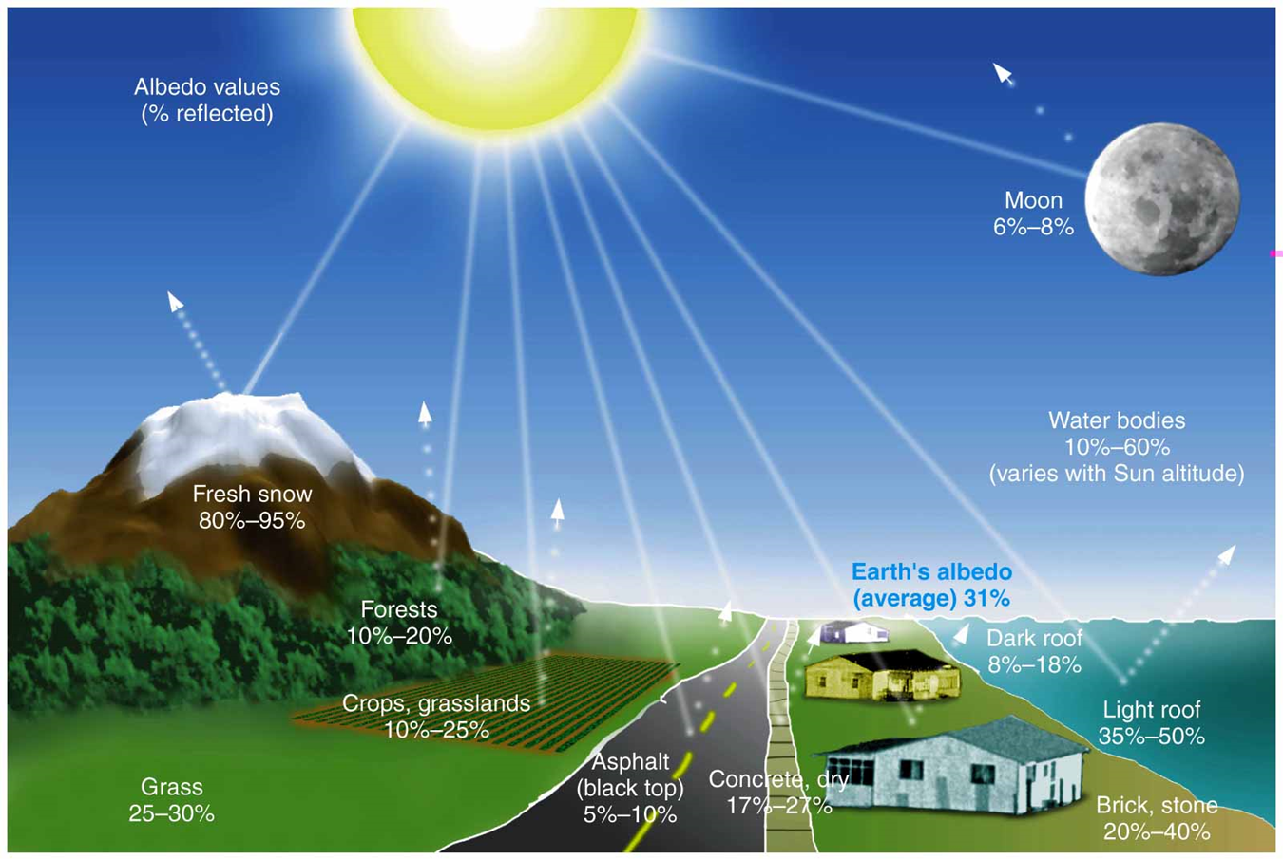

Slide 14
12.1.1 Shape from shading and photometric stereo
smoothness constraint:
integrability constraint
Notes:
Unfortunately, unless additional constraints are imposed, there
are more unknowns per pixel (p; q) than there are measurements (I) 第三章
for a valid depth map z(x; y) with (p; q) = (zx; zy), we have py = zxy = zyx = qx
an assumption that pixel values will change slowly as you move in any direction, and they‘ll likely be close in value to their neighbors 平滑約束

Slide 15
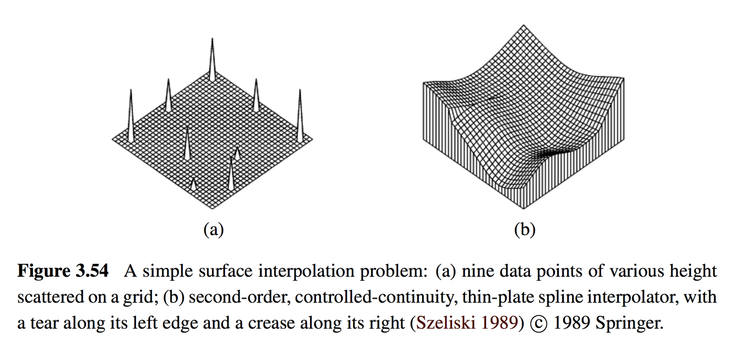
Smoothness Constraint

Slide 16
12.1.1 Shape from shading and photometric stereo
Photometric stereo
Another way to make shape from shading more reliable is to use multiple light sources that can be selectively turned on and off.
Notes:
立體光學法（Photometric Stereo）
為了彌補光度成形法中單張照片提供之資訊不足，立體光學法採用一個相機拍攝多張照片，這些照片的拍攝角度是相同的，其中的差別是光線的照明條件。最簡單的立體光學法使用三盞光源，從三個不同的方向照射待測物，每次僅開啟一盞光源。拍攝完成後再綜合三張照片並使用光學中的完美漫射（perfect diffusion）模型解出物體表面的梯度向量（gradients），經過向量場的積分後即可得到三維模型。此法並不適用於光滑而不近似於朗伯表面（Lambertian surface）的物體

Slide 17
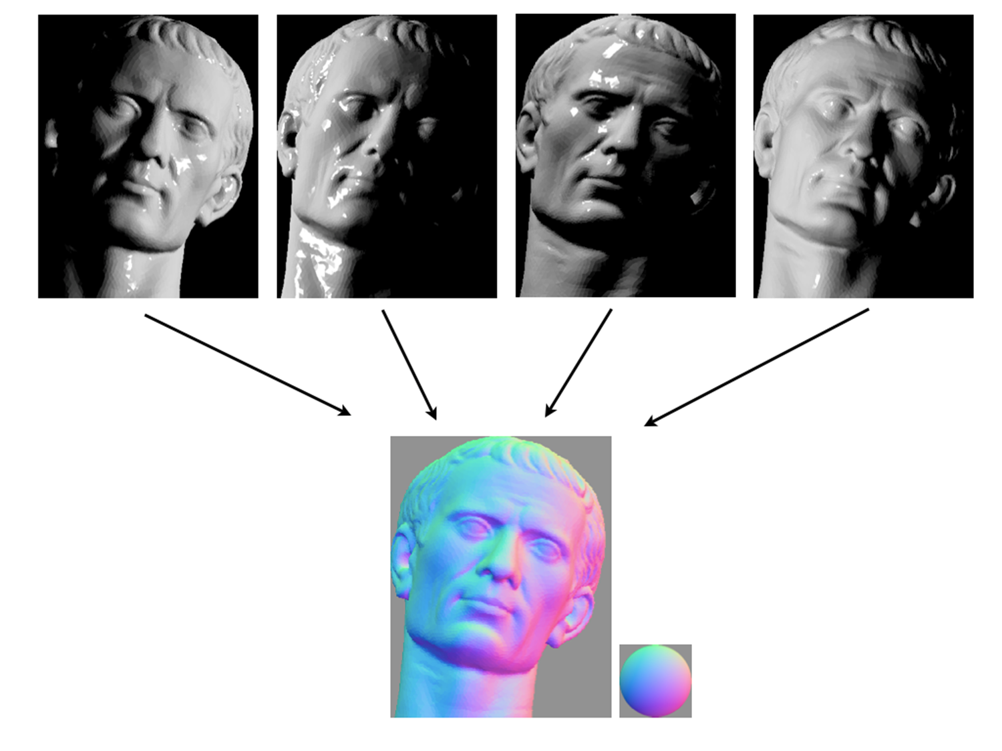
Notes:
法向量還原

Slide 18
Take a Break!
Q: 軟體工程師最常說的謊言有哪些？
A: //TODO

Slide 19
12.1.2 Shape from texture
Shape from texture
The foreshortening of regular patterns as the surface slants or bends away from the camera.
Notes:
透視法縮短 拿筆來示範 傾斜彎曲

Slide 20
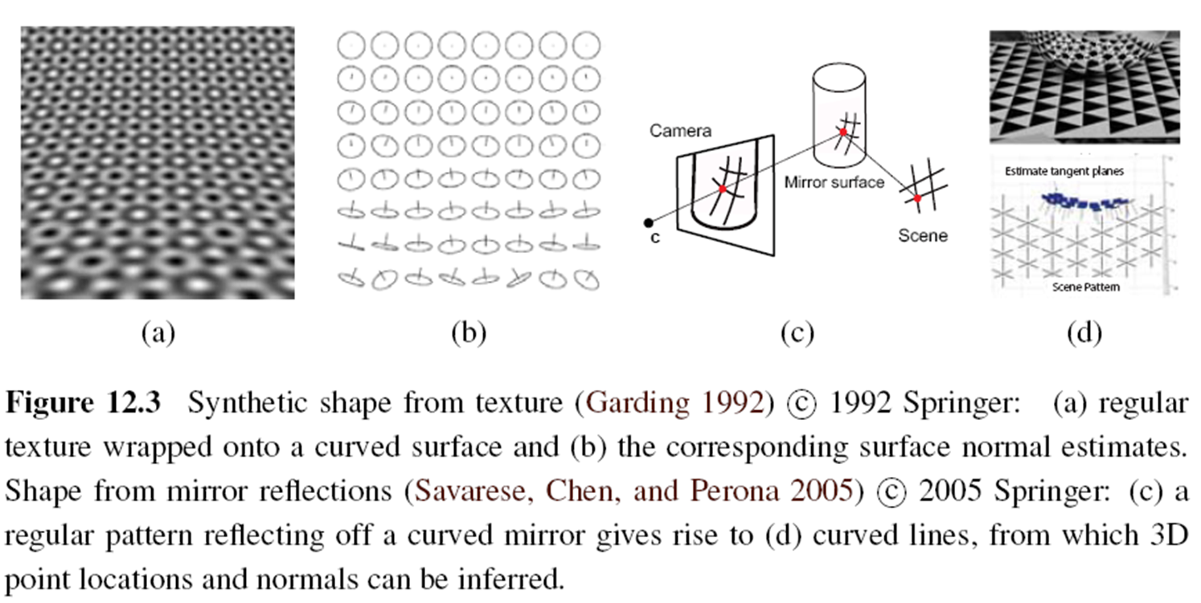
12.1.2 Shape from texture

Slide 21
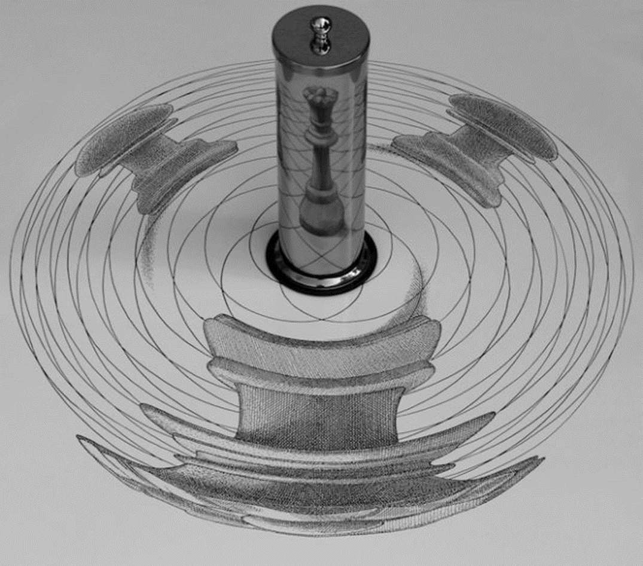

Slide 22
12.1.3 Shape from focus
Shape from focus
A strong cue for object depth is the amount of blur, which increases as the object’s surface moves away from the camera’s focusing distance.
The amount of blur increases in both directions as you move away from the focus plane. Therefore, it is necessary to
use two or more images captured with different focus distance settings
or to translate the object in depth and look for the point of maximum sharpness.

Slide 23


Slide 24
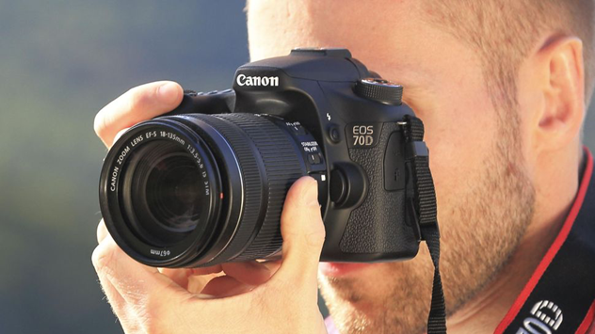
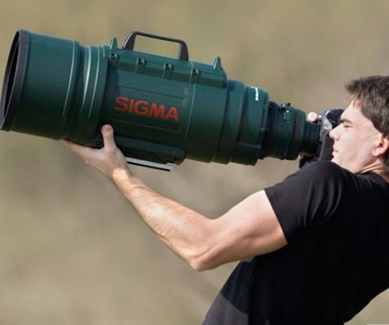
12.1.3 Shape from focus
The magnification of the object can vary as the focus distance is changed or the object is moved. This can be modeled either explicitly (making correspondence more difficult) or using telecentric optics, which approximate an orthographic camera and require an aperture in front of the lens.
Notes:
Telecentric 遠心鏡頭
Orthographic 直角的
Aperture 光圈

Slide 25
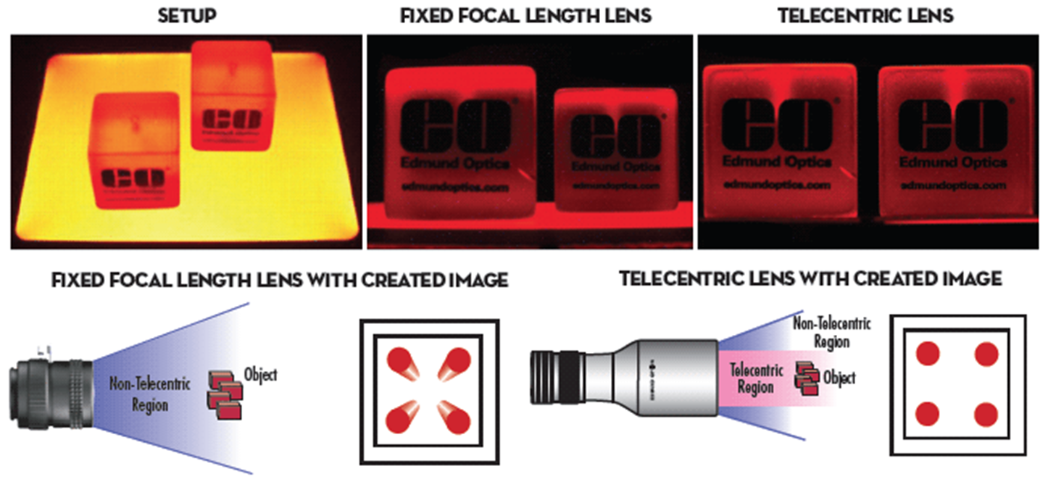

Slide 26
12.1.3 Shape from focus
The amount of defocus must be reliably estimated. A simple approach is to average the squared gradient in a region but this suffers from several problems, including the image magnification problem mentioned above. A better solution is to use carefully designed rational filters.
Notes:
Rational 合理的

Slide 27
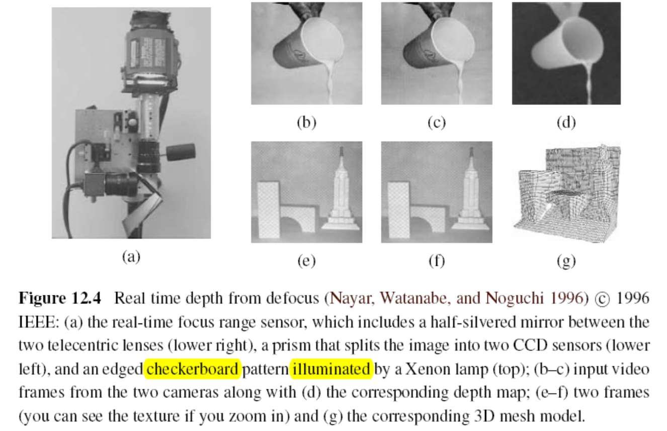
http://www.cs.columbia.edu/CAVE/projects/depth_defocus/
Notes:
Defocus : 散焦
Prism 凌鏡
Checkerboard 格子板
Xenon 氙氣
CCD 電耦合

Slide 28
Take a Break!
Q: 身為IT從業人員，你覺得有甚麼工具大大提供了工作效率？
A: 單身

Slide 29
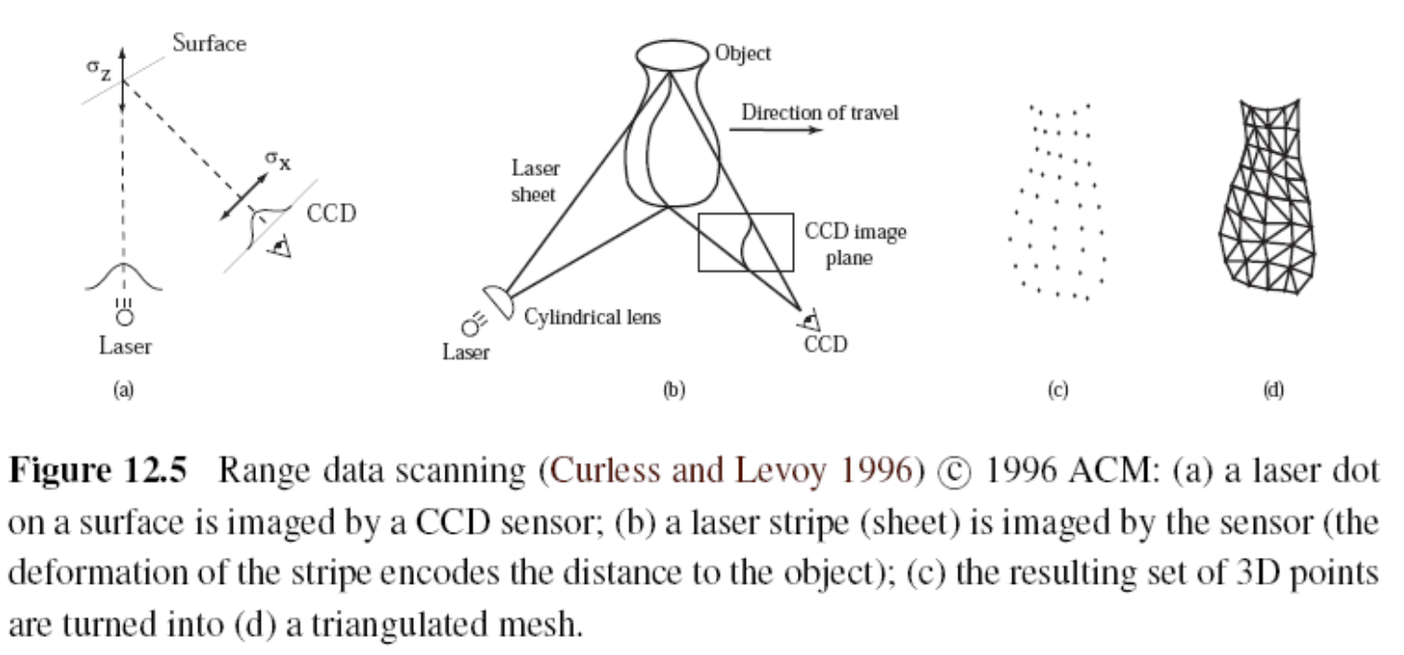
12.2 Active Rangefinding
Notes:
Stripe 長條
Deformation 變形
Triangulated mesh 三角測量網線

Slide 30
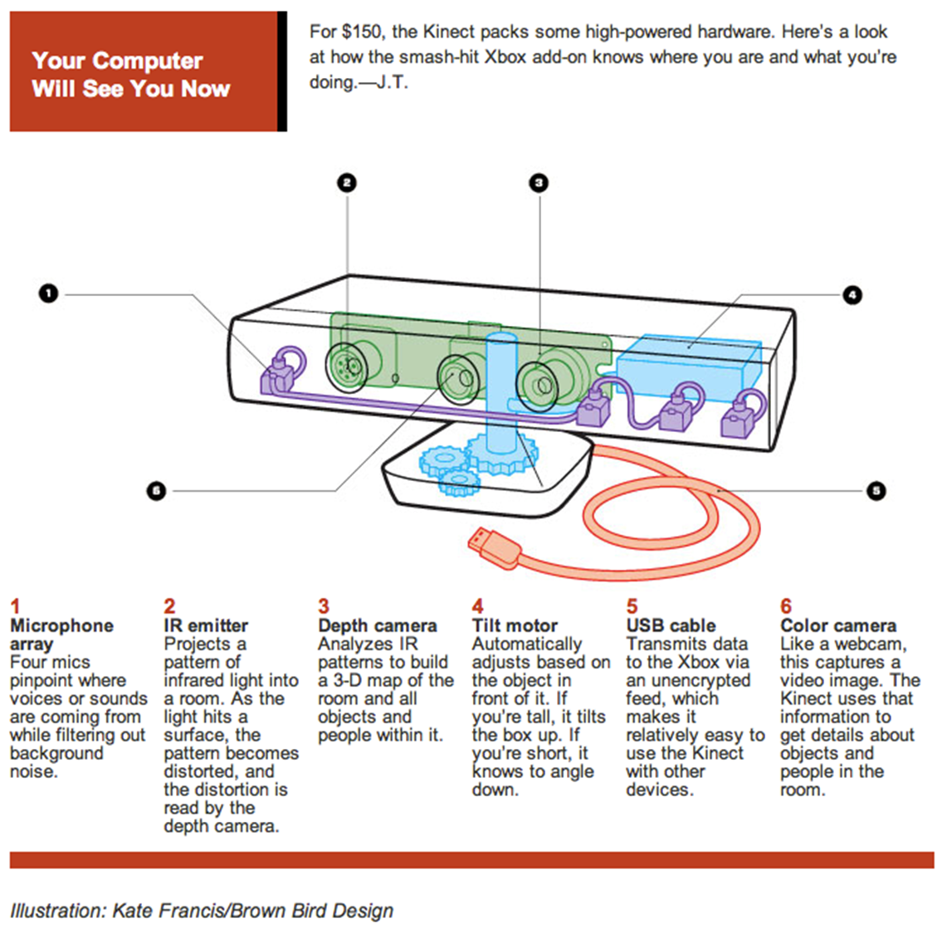
12.2 Active Rangefinding
Kinect
Azure Kinect DK

Slide 31
12.2 Active Rangefinding
Tango
ARCore

Slide 32
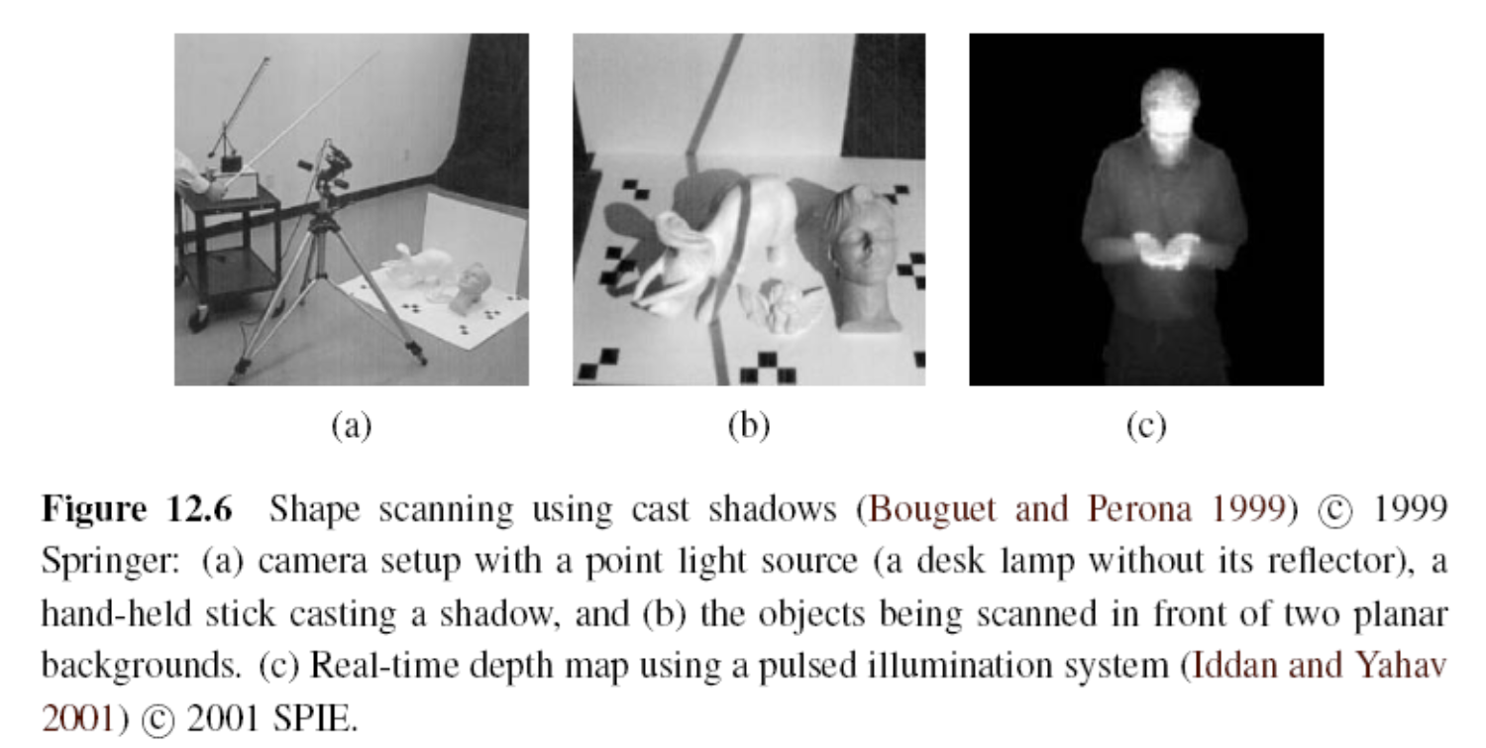
12.2 Active Rangefinding
SPIE: Society of Photo-Optical Instrumentation Engineers
Notes:
Cast 投射

Slide 33
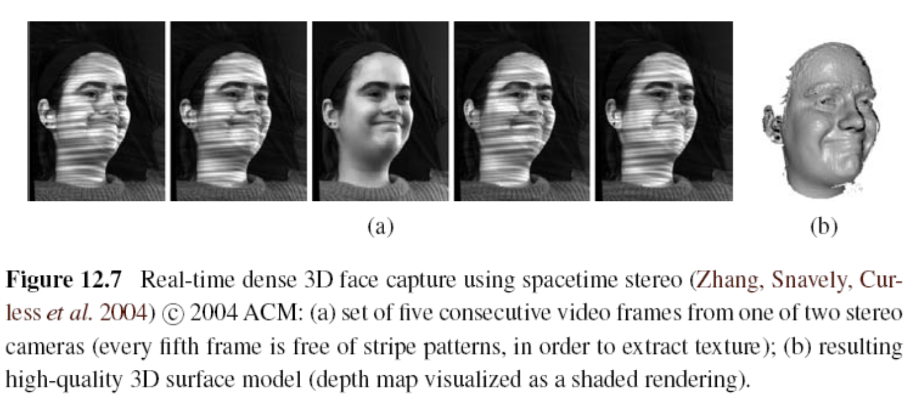
12.2 Active Rangefinding

Slide 34
12.2 Active Rangefinding
NBA 2K15
Bad face scan
NBA 2K19 face scan

Slide 35
12.2.1 Range Data Merging
Range data merging
The registration (alignment) of partial 3D surface models and their integration into coherent 3D surfaces.
Iterated Closest Point (ICP)
Which alternates between finding the closest point matches between the two surfaces being aligned and then solving a 3D absolute orientation problem
Notes:
範圍數據合併
迭代最近點
ICP用來將兩群點集合（ point set ）對齊的演算法
假設有兩個點集合 P 和 Q ，其中 P 和 Q 裡面的點數目未必一樣。
如果我知道 P 裡面的每個點都能在 Q 裡面找到相對應的點，經過一次平移和旋轉，可以讓 P 和 Q 之間的誤差最小

Slide 36
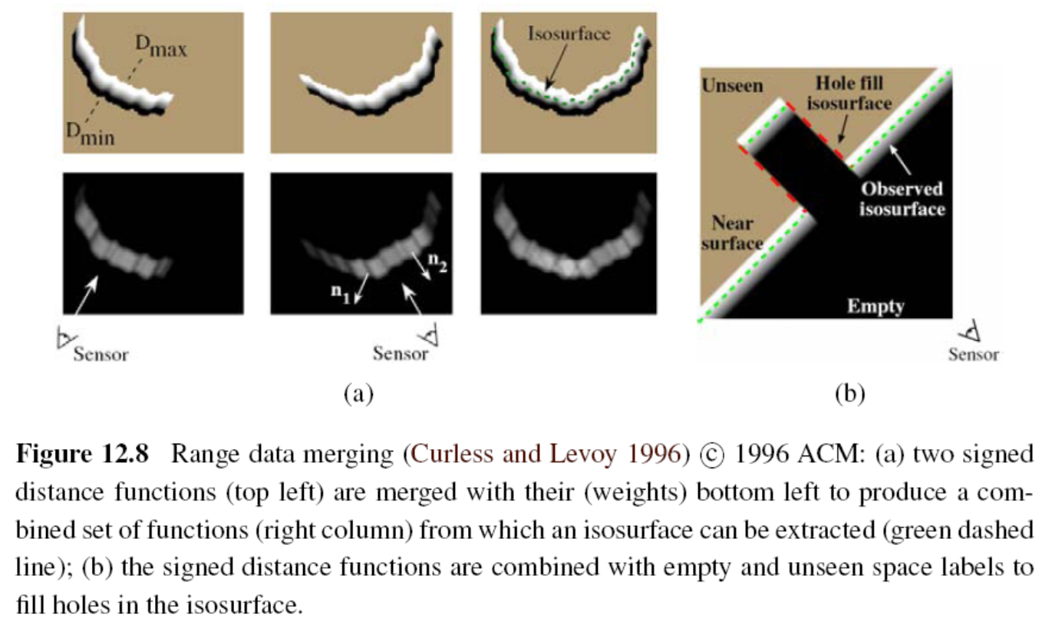
12.2.1 Range Data Merging
Notes:
Isosurface: 等值曲面

Slide 37
12.2.1 Range Data Merging
Sparse Iterative Closest Point(video)
Sparse Iterative Closest Point (introduction)

Slide 38
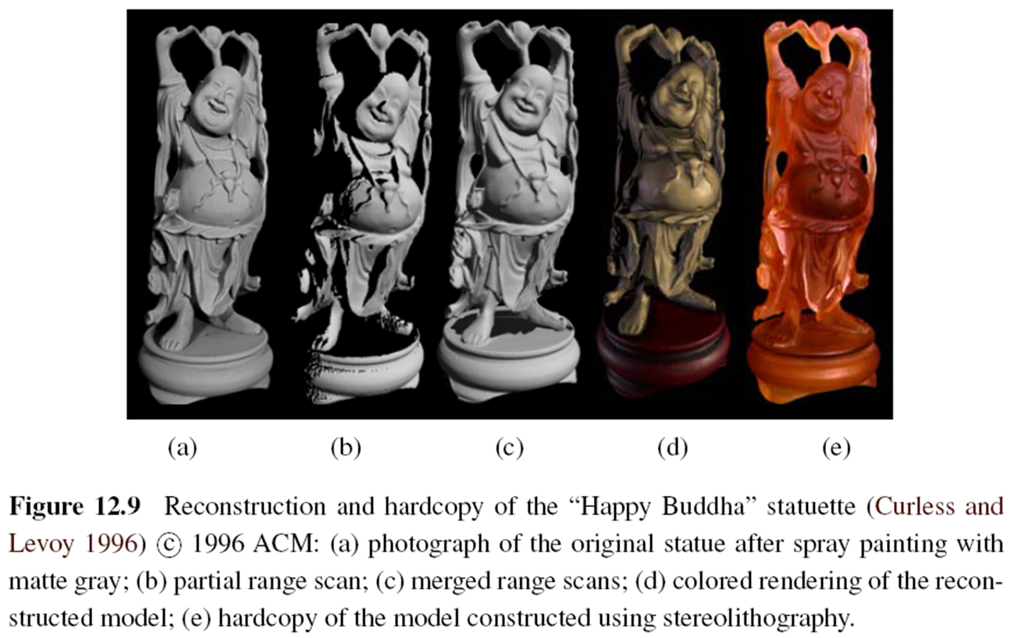
12.2.1 Range Data Merging
Notes:
Stereolithography:光固化

Slide 39
Stereolithography (SLA) Technology
Stereolithography

Slide 40
12.2.2 Application: Digital Heritage
Active rangefinding technologies, combined with surface modeling and appearance modeling techniques (Section 12.7), are widely used in the fields of archeological and historical preservation, which often also goes under the name digital heritage (MacDonald 2006).
In such applications, detailed 3D models of cultural objects are acquired and later used for applications such as analysis, preservation, restoration, and the production of duplicate artwork
Notes:
Archeological 考古
Heritage 遺產
雷射測距儀

Slide 41
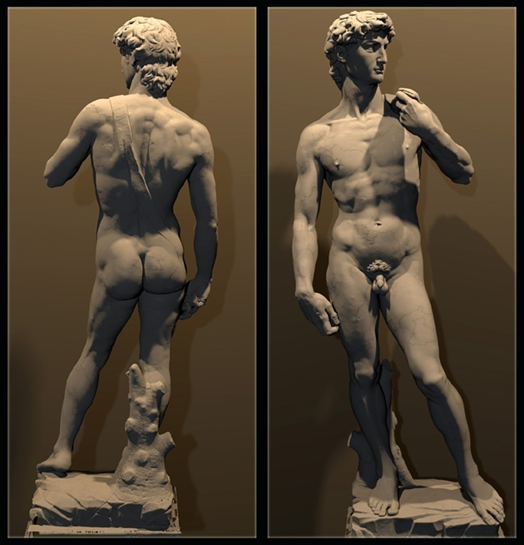
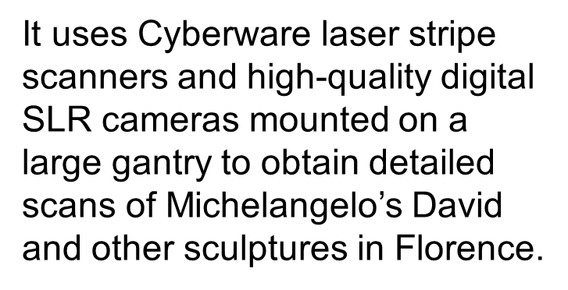
12.2.2 Application: Digital Heritage
The Digital Michelangelo project
laser scan of the David
Notes:
Gantry 起重機
Mounted 架設好的

Slide 42
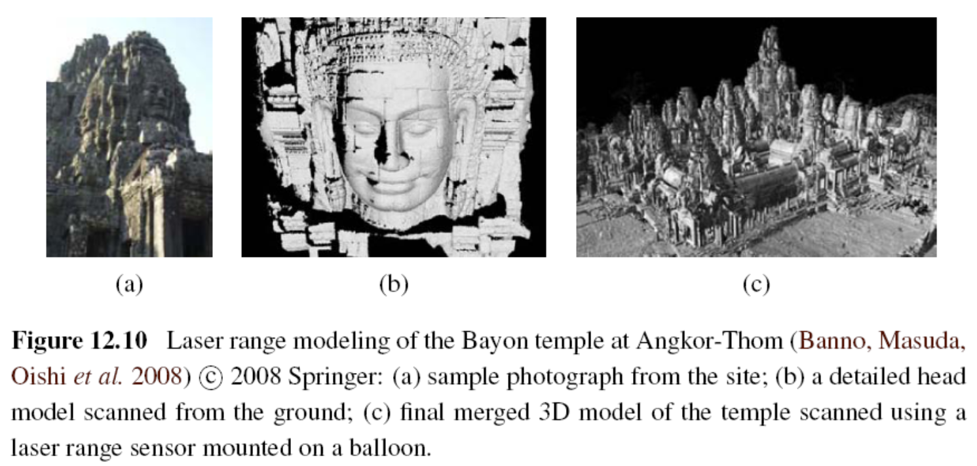
12.2.2 Application: Digital Heritage
Notes:
巴戎廟是吳哥城(Angkor Thom)中最著名最莊觀的一座廟，構造以大尊佛像頭部主，形成一群又一群的塔，遠看似聳起的山頭。原本有49座塔， 現在只剩下只37座塔，大部份塔頂都雕刻有佛像頭。

Slide 43
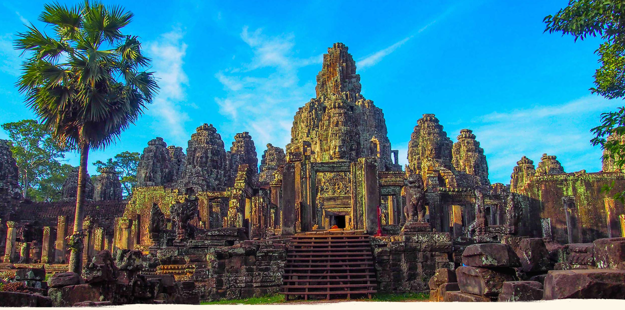

Slide 44
Take a Break!
Q: 有哪些垃圾手機app？
A: 簡訊過濾app！過濾之後告訴你它過濾了一則垃圾訊息，99%的人會再點進去看一下被過濾的訊息。

Slide 45
12.3 Surface Representations
Surface representations
- Triangle Meshes
- Splines (Farin 1992, 1996)
- Subdivision Surfaces (Stollnitz, DeRose, and Salesin 1996; Zorin, Schr¨oder, and Sweldens 1996; Warren and Weimer 2001; Peters and Reif 2008)
Notes:
三角網格是多邊形網格的一種，多邊形網格又被稱為“Mesh”，是計算機圖形學中用於為各種不規則物體建立模型的一種資料結構
Subdivision surfaces細分曲面
Splines樣條函數
樣條通常是指分段定義的多項式參數曲線

Slide 46
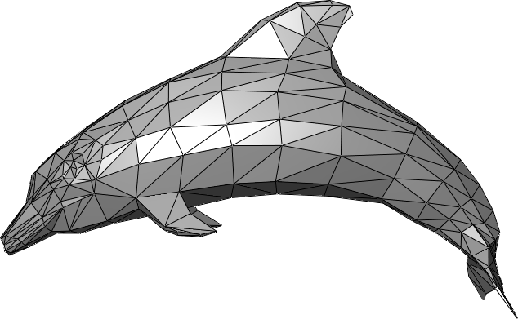
Triangle Meshes

Slide 47
12.3 Surface Representations
Introduction to subdivision surfaces

Slide 48
12.3 Surface Representations
It enables not only the creation of highly detailed models but also processing operations, such as interpolation (Section 12.3.1), fairing or smoothing, and decimation and simplification (Section 12.3.2).
Notes:
Decimation 毀滅
fair 光順 整流

Slide 49
12.3.1 Surface Representations
One of the most common operations on surfaces is their reconstruction from a set of sparse data constraints, i.e. scattered data interpolation
Notes:
Sparse data constraints 稀疏資料限制
在資料庫中，稀疏資料是指在二維表中含有大量空值的資料；即稀疏資料是指，在資料集中絕大多數數值缺失或者為零的資料。稀疏資料絕對不是無用資料，只不過是資訊不完全，通過適當的手段是可以挖掘出大量有用資訊

Slide 50
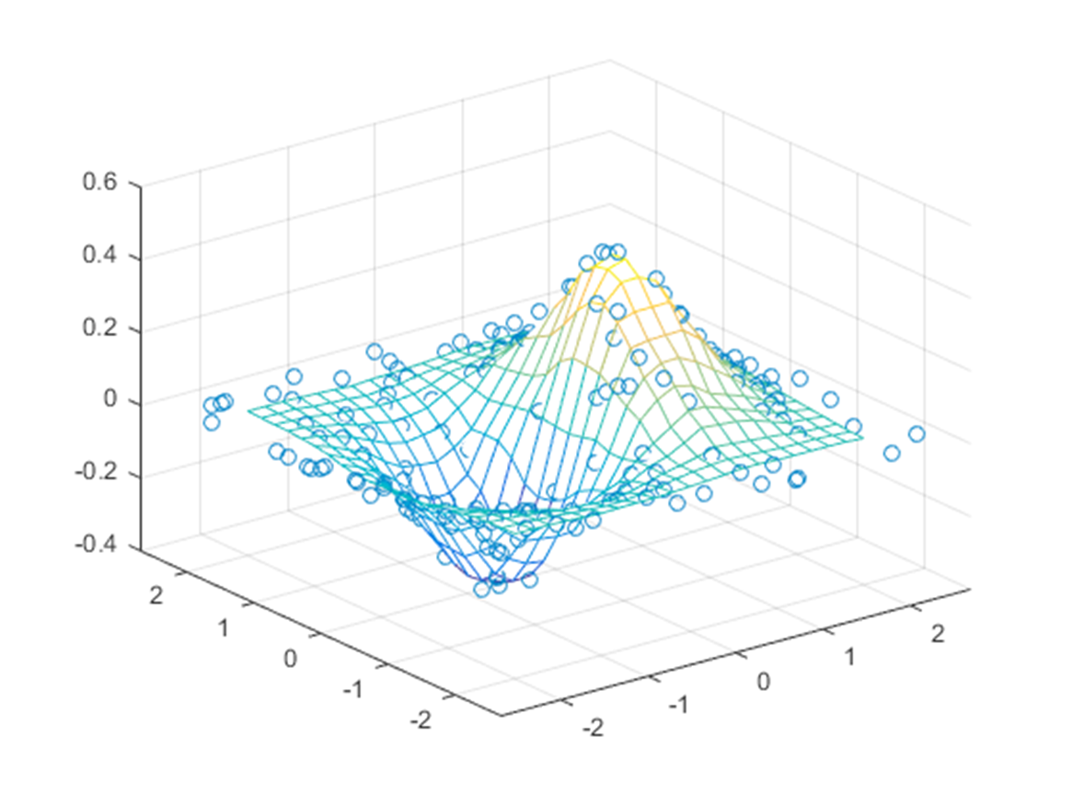
12.3.1 Surface Representations

Slide 51
12.3.1 Surface Representations
Radial basis (or kernel) functions (Boult and Kender 1986; Nielson 1993)
To interpolate a field f(x) through (or near) a number of data values d_{i} located at x_{i}, the radial basis function approach uses
where the weights,
are computed using a radial basis (spherically symmetrical) function K(r).
Notes:
徑向基函數核
K 兩個特徵向量之間的平方歐幾里得距離

Slide 52
12.3.2 Surface Simplification
Once a triangle mesh has been created from 3D data, it is often desirable to create a hierarchy of mesh models, for example, to control the displayed Level Of Detail (LOD) in a computer graphics application
LOD
Notes:
Hierarchy 階層
Lod細節層次
隨著物體或者模型遠離觀察者而逐步降低。由於它能夠通過減少多邊形的數目從而提升渲染效率，所以在計算機與視頻遊戲中使用了這項技術。由於物體距離很遠，所以理論上並不會察覺到模型或者物體的視覺質量會有所下降

Slide 53
12.3.2 Surface Simplification
To approximate a given mesh with one that has subdivision connectivity, over which a set of triangular wavelet coefficients can then be computed. (Eck, DeRose, Duchamp et al. 1995)
To use sequential edge collapse operations to go from the original fine-resolution mesh to a coarse base-level mesh (Hoppe 1996)
Notes:
Coarse 粗糙的
edge collapse
主要是用二個在幾何模型上的運算：edge collapse、vertex split，來達到幾何模型
的簡化。每次edge collapse 會將二個頂點變成一個頂點，並將共享此邊的二個三角形
拿掉。每次簡化的過程會被記錄，而後能由最簡的模型反推回原來的模型。在簡化的
過程中，每次會挑選簡化後產生誤差最小的邊來作edge collapse

Slide 54
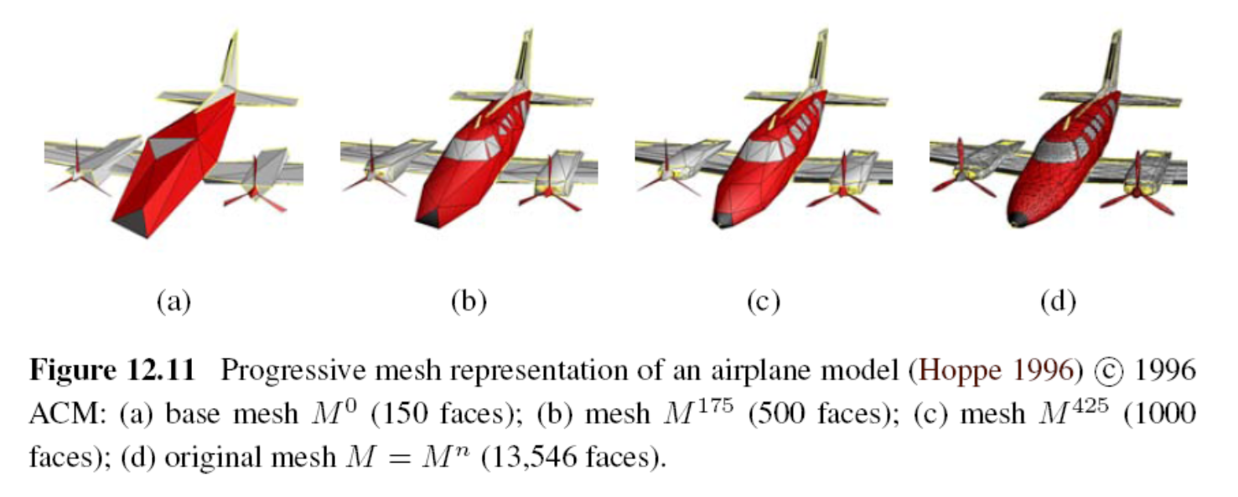
12.3.2 Surface Simplification

Slide 55
12.3.3 Geometry Images
To make meshes more easy to compress and store in a cache-efficient manner.
To create geometry images by cutting surface meshes along well chosen lines and “flattening” the resulting representation into a square.(Gu, Gortler, and Hoppe (2002))
Notes:
Geometry 幾何學
Cache快取記憶體

Slide 56
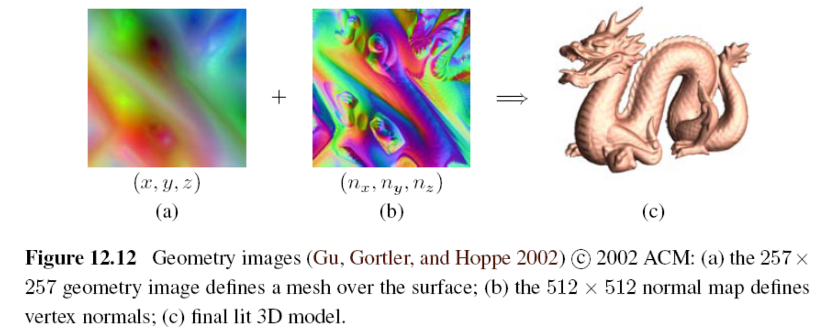
12.3.3 Geometry Images

Slide 57
Take a Break!
Q: 有哪些東西你覺得很貴，但其實很便宜？
A: 大學剛畢業的我

Slide 58
12.4 Point-based Representations
To dispense with an explicit triangle mesh altogether and to have triangle vertices behave as oriented points, or particles, or surface elements (surfels) (Szeliski and Tonnesen 1992)
Notes:
Dispense 免除
不用網格 用頂點

Slide 59
12.4 Point-based Representations
How to render the particle system as a continuous surface :
- local dynamic triangulation heuristics
(Szeliski and Tonnesen 1992)
- direct surface element splatting
(Pfister, Zwicker, van Baar et al. 2000)
- Moving Least Squares (MLS)
(Pauly, Keiser,Kobbelt et al. 2003)
Notes:
Render 呈現
Heuristics 策略法
Splat 點

Slide 60
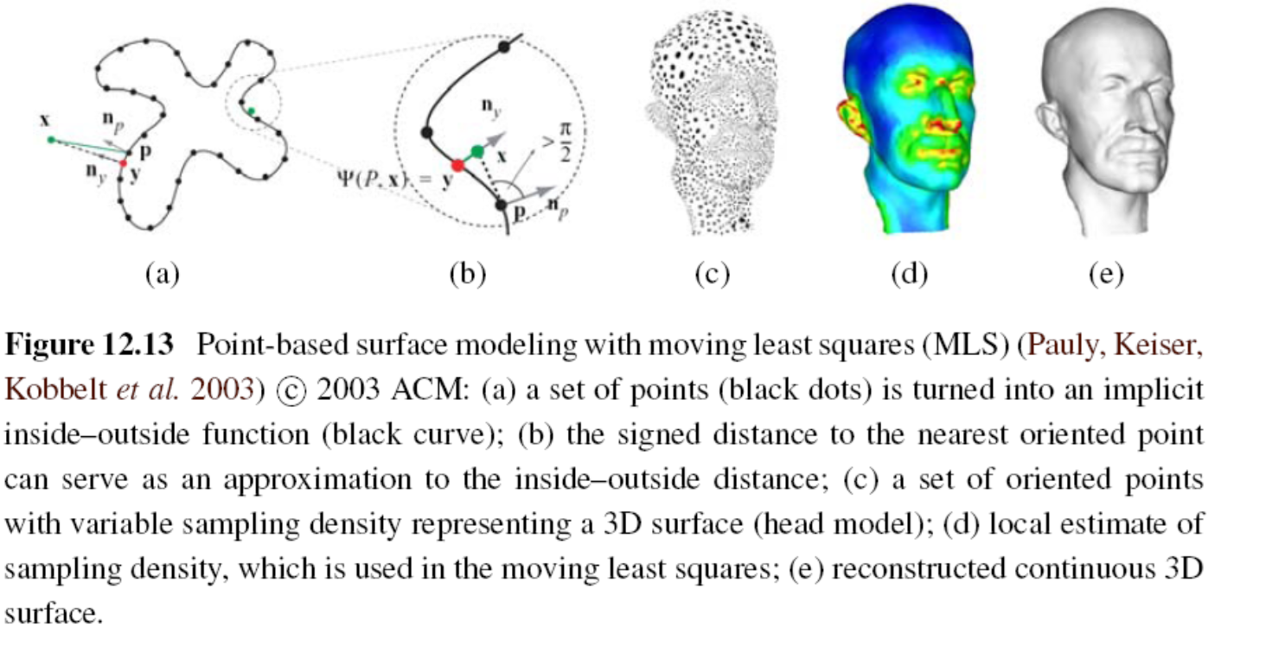
12.4 Point-based Representations
Notes:
MLS is a method for reconstructing continuous functions from a set of unorganized point samples via the calculation of a weighted least squares measure biased towards the region around the point at which the reconstructed value is requested
移動式最小平方法

Slide 61
12.5 Volumetric Representations
A third alternative for modeling 3D surfaces is to construct 3D volumetric inside–outside functions
Implicit (inside–outside) functions to represent 3D shape
Notes:
體積的表示法
Implicit 絕對的

Slide 62
12.5.1 Implicit Surfaces and Level Sets
implicit surfaces
which use an indicator function (characteristic function) F(x; y; z) to indicate which 3D points are inside F(x; y; z) < 0 or outside F(x; y; z) > 0 the object

Slide 63
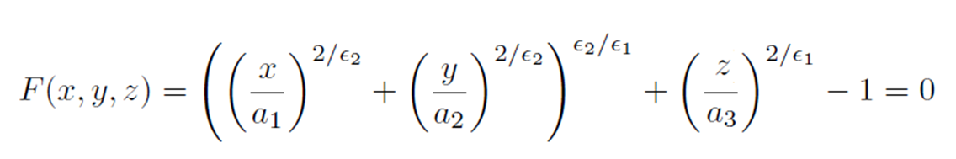
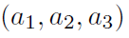
12.5.1 Implicit Surfaces and Level Sets
Implicit (inside-outside) functions of superquadrics:
The values of control the extent of model along each (x; y; z) axis, while the values of control how “square” it is.
Notes:
超二次曲面體 superquadrics
是一類幾何體，其表面方程由橢球體或其他二次曲面體方程演化而來。將橢球體表面方程中的指數由2更改為其他任意正實數，即得到超二次曲面體
可以表達圓角或近似方角的立方體、八面體、圓柱等諸多形狀，是一種很好的計算機三維圖形模型
Extent 長度

Slide 64
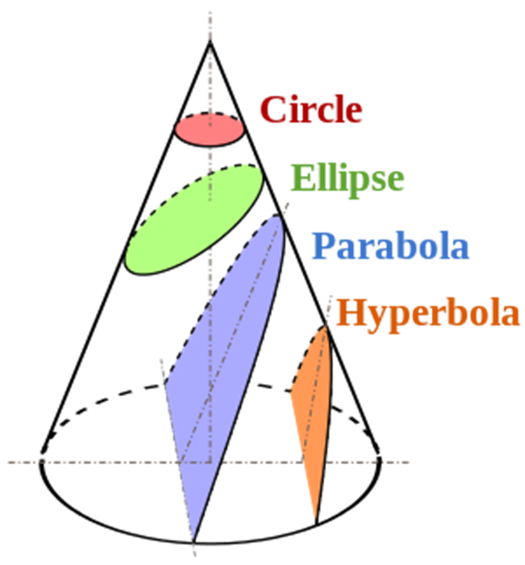
Conics (2D Curve)
Notes:
Conics 圓錐曲線 two dimensional curve
Parabola 拋物線
Hyperbola 雙曲線
不同切面會有不同圖形

Slide 65
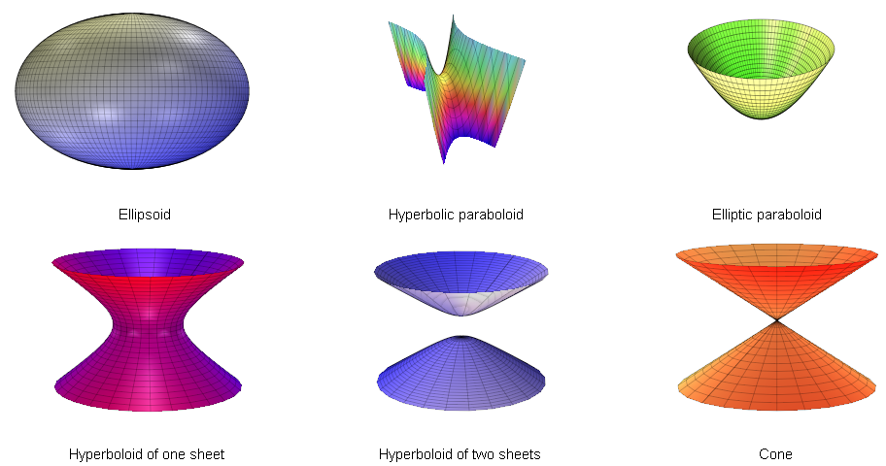
Quadric
Notes:
Quadric二次曲面
the three dimensional analogue(類似) of the conics

Slide 66
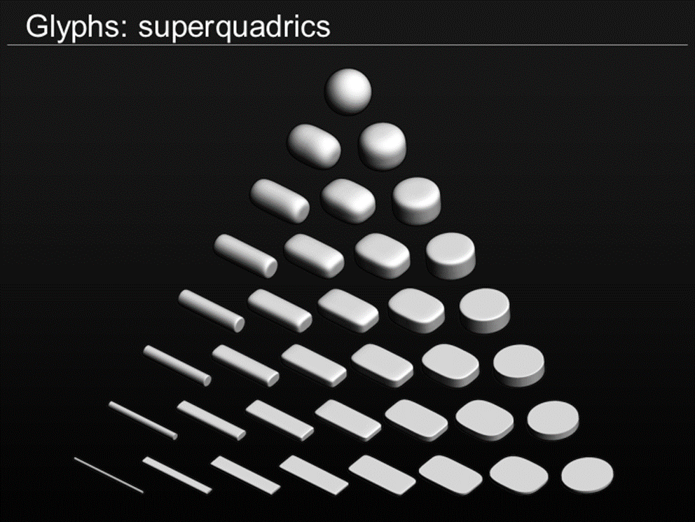
Superquadrics
Notes:
These are an extension of quadrics, where the power on the coordinate does not have to be 2
各參數不侷限2次了

Slide 67
12.5.1 Implicit Surfaces and Level Sets
A different kind of implicit shape model can be constructed by defining a signed distance function over a regular three-dimensional grid, optionally using an octree spline to represent this function more coarsely away from its surface (zero-set) (Lavall´ee and Szeliski 1995 Szeliski and Lavall´ee 1996; Frisken, Perry, Rockwood et al. 2000; Ohtake, Belyaev, Alexaet al. 2003)
Notes:
Signed distance function 正負號距離表示法

Slide 68
12.5.1 Implicit Surfaces and Level Sets
Examples of signed distance functions being used
- distance transforms (Section 3.3.3)
- level sets for 2D contour fitting and tracking (Section 5.1.4)
- volumetric stereo (Section 11.6.1)
- range data merging (Section 12.2.1)
- point-based modeling (Section 12.4)

Slide 69
Take a Break!
Q: 同事說自己的C++能力是世界第一，怎樣可以讓他意識到自己沒那麼厲害？
A: 實不相瞞，我也不是省油的燈：我的C++實力世界第0

Slide 70
12.6 Model-based Reconstruction
12.6.1 Architecture
12.6.2 Heads and faces
12.6.3 Application: Facial animation
12.6.4 Whole body modeling and tracking

Slide 71
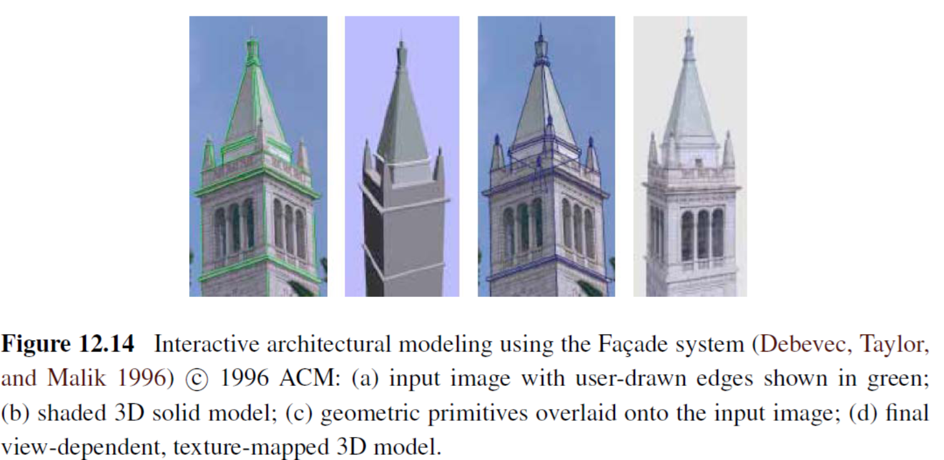
12.6.1 Architecture
Notes:
Primitive 原始
Overlaid 覆蓋

Slide 72
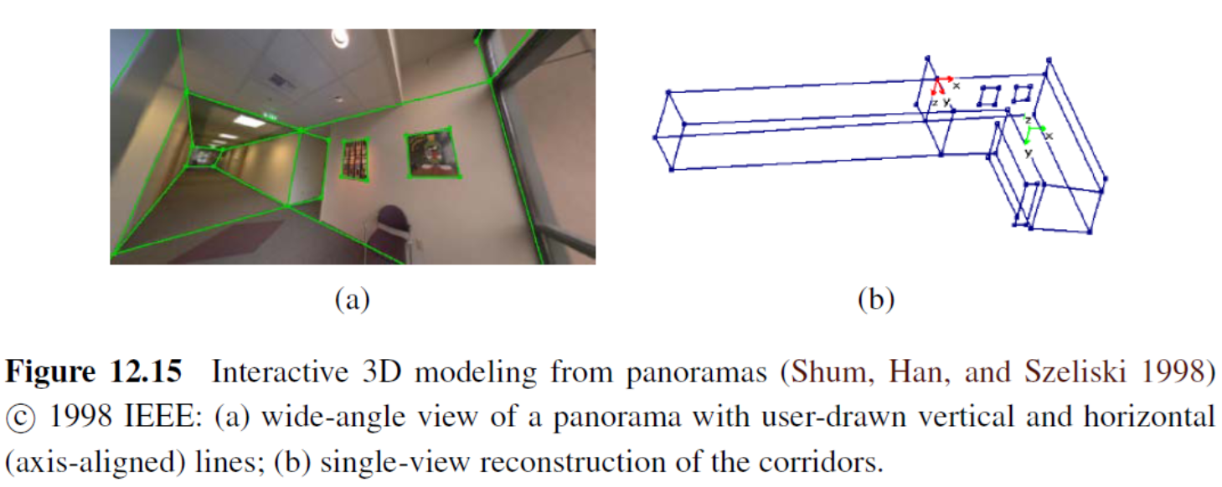
12.6.1 Architecture
Architectural interior modeling
Lumion 9
Notes:
Interior 室內
Lumion 9

Slide 73
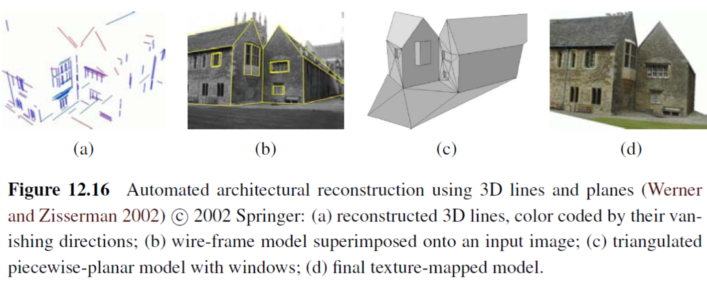
12.6.1 Architecture
Automated line-based reconstruction
Notes:
Wire-frame 線框
Superimposed 疊加

Slide 74
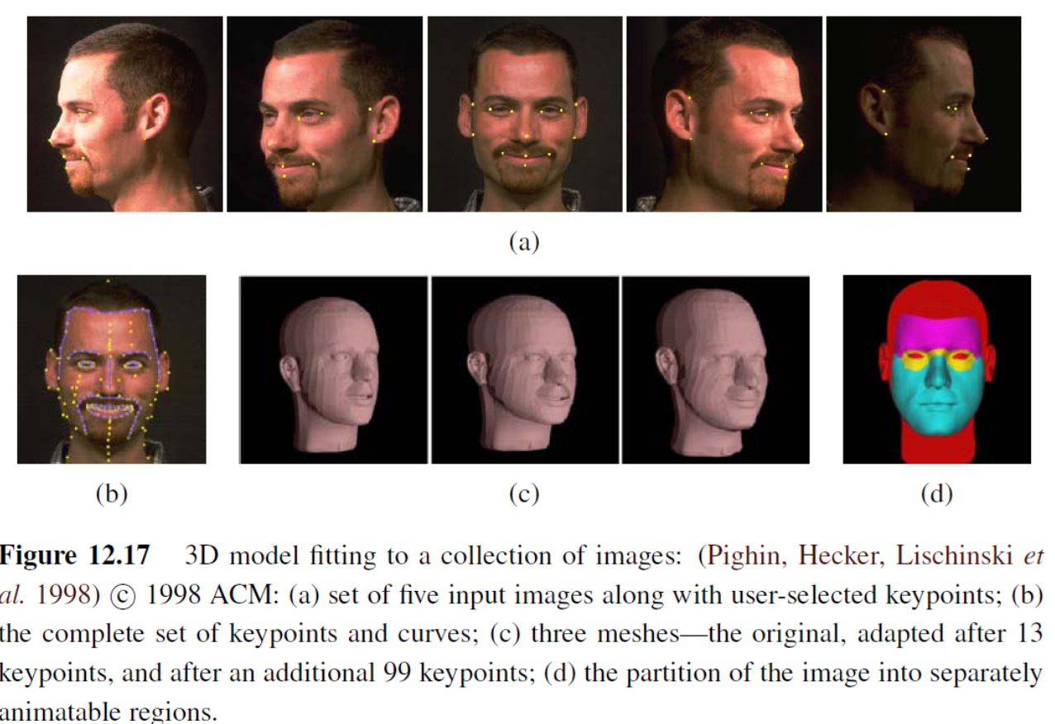
12.6.2 Heads and Faces

Slide 75
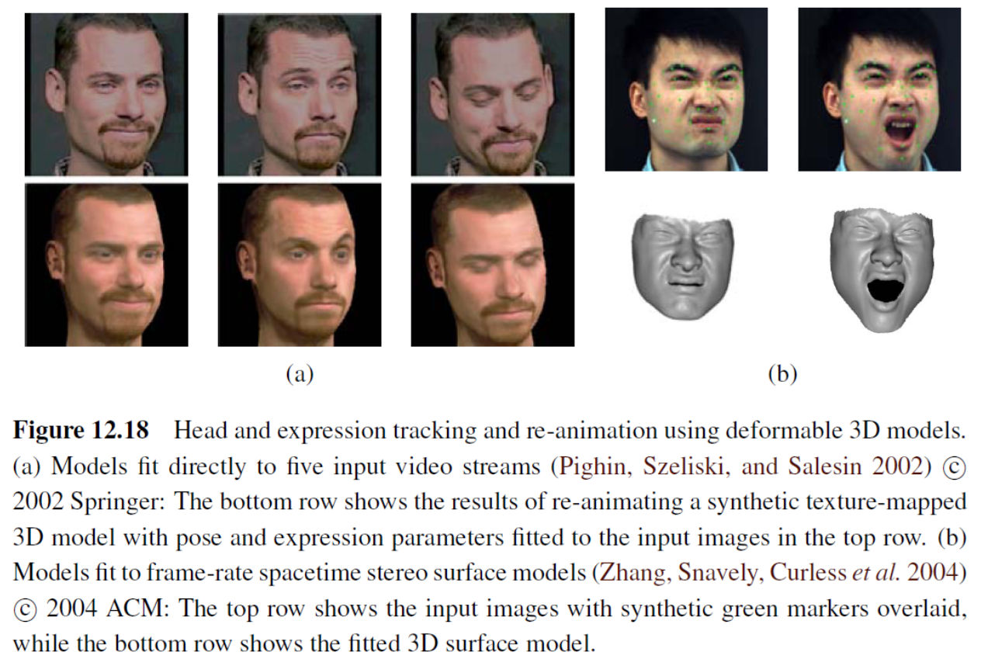
12.6.2 Heads and Faces

Slide 76
12.6.2 Model-based Reconstruction
3D head model applications
head tracking
face transfer, i.e., replacing one person’s face with another in a video
face beautification by warping face images toward a more attractive “standard”
face de-identification for privacy protection
face swapping
Notes:
(Toyama 1998; Lepetit, Pilet, and Fua 2004; Matthews, Xiao, and Baker
2007), as shown in Figures 4.29 and 14.24
(Bregler, Covell, and Slaney 1997; Vlasic, Brand, Pfister et al.2005)
(Leyvand, Cohen-Or, Dror et al. 2008)
(Gross, Sweeney, De la Torre et al. 2008) 去識別化
(Bitouk,Kumar, Dhillon et al. 2008)

Slide 77
3D Head Model Applications
face swap from Microsoft
deepfake damage
Mrdeepfakes
Fake videos of real people -- and how to spot them

Slide 78
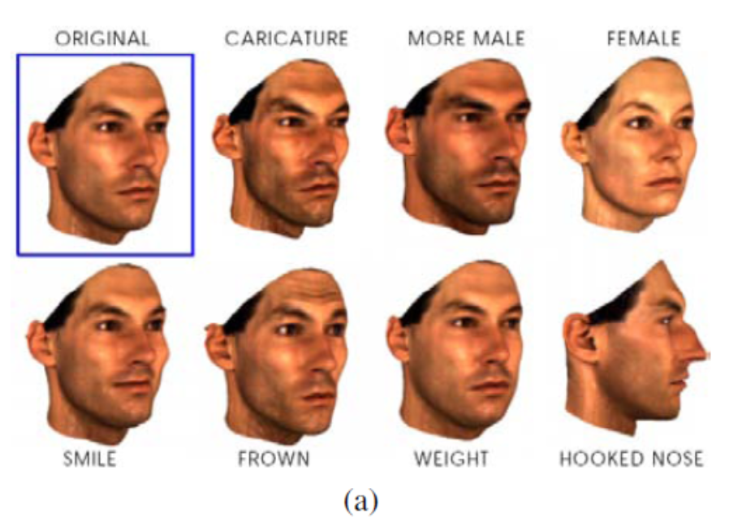
12.6.3 Application: Facial Animation
(a) Original 3D face model with the addition of shape and texture variations in specific direction: deviation from the mean (caricature), gender, expression, weight, and nose shape
Notes:
Caricature 諷刺

Slide 79
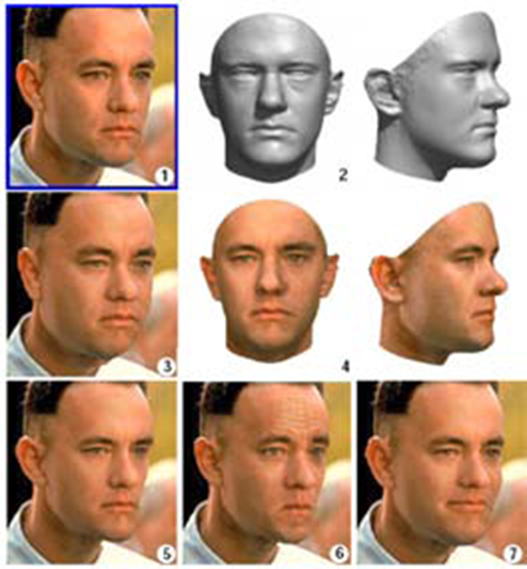
12.6.3 Application: Facial Animation
Notes:
Morphable 型變

Slide 80
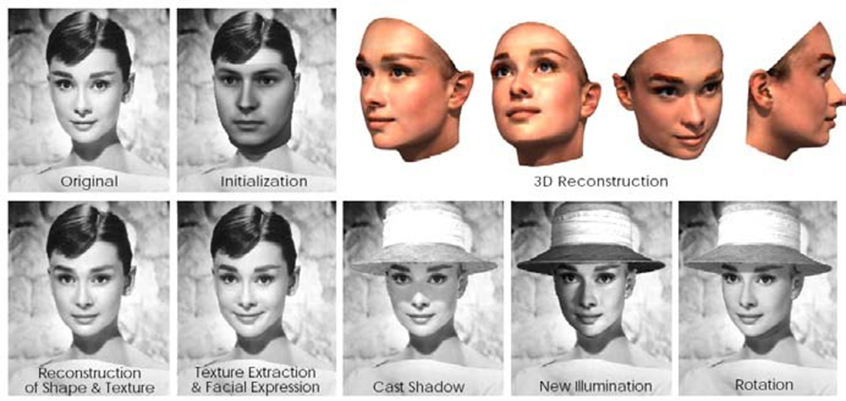
12.6.3 Application: Facial Animation
(c) another example of a 3D reconstruction along with a different set of 3D manipulations such as lighting and pose change.

Slide 81
12.6.3 Application: Facial Animation
Morphable Face: Automatic 3D Reconstruction and Manipulation from Single Data-Set Reference Face
https://www.youtube.com/watch?v=fu7bTemvEKk

Slide 82
12.6.3 Application: Facial Animation
Photoreal Digital Actor
https://www.youtube.com/watch?v=piJ4Zke7EUw
Tomb Raider

Slide 83
Take a Break!
Q: 為什麼很多人都買筆電來打電動，而不是買性能更好的桌機？
A: 因為買不起房子…

Slide 84
12.6.4 Whole Body Modeling and Tracking
Background subtraction
Initialization and detection
Tracking with flow
3D kinematic models
Probabilistic models
Adaptive shape modeling
Activity recognition

Slide 85
12.6.4 Whole Body Modeling and Tracking
Background Subtraction
- One of the first steps in many (but certainly not all) human tracking systems is to model the background in order to extract the moving foreground objects (silhouettes) corresponding to people.
- Once silhouettes have been extracted from one or more cameras, they can then be modeled using deformable templates or other contour models
Notes:
Silhouettes 剪影

Slide 86
12.6.4 Whole Body Modeling and Tracking
Initialization and Detection
- In order to track people in a fully automated manner, it is necessary to first detect (or re-acquire) their presence in individual video frames.
- This topic is closely related to pedestrian detection, which is often considered as a kind of object recognition (Mori, Ren, Efros et al. 2004; Felzenszwalb and Huttenlocher 2005; Felzenszwalb, McAllester, and Ramanan 2008
pedestrain detection
Notes:
行人偵測。早期做法是 image feature description 。近期做法是 neural network
treated in more depth in Section 14.1.2.

Slide 87
12.6.4 Whole Body Modeling and Tracking
3D Kinematic Models
- which specifies the length of each limb in a skeleton as well as the 2D or 3D rotation angles between the limbs or segments
Notes:
Limb 肢

Slide 88
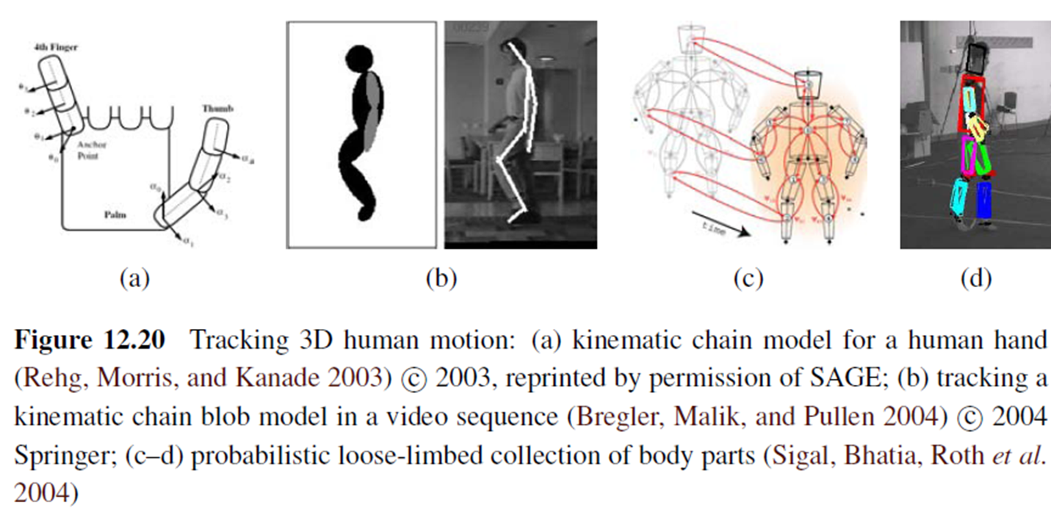
12.6.4 Whole Body Modeling and Tracking
Realtime Multi-Person 2D Human Pose Estimation using Part Affinity Fields

Slide 89
12.6.4 Whole Body Modeling and Tracking
Probabilistic Models
- Because tracking can be such a difficult task, sophisticated probabilistic inference techniques are often used to estimate the likely states of the person being tracked
Notes:
Sophisticated 老練的

Slide 90
12.6.4 Whole Body Modeling and Tracking
Adaptive Shape Modeling
- Another essential component of whole body modeling and tracking is the fitting of parameterized shape models to visual data

Slide 91
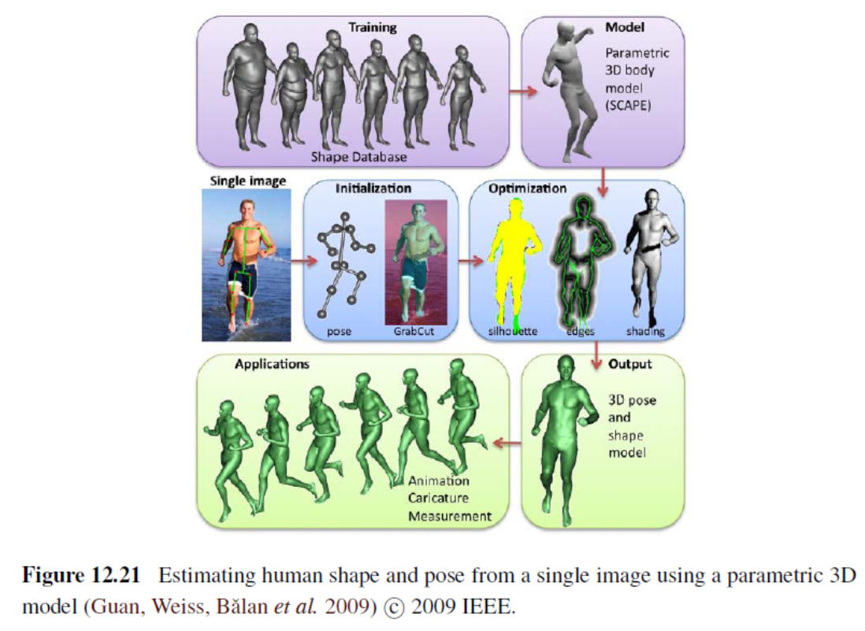
12.6.4 Whole Body Modeling and Tracking

Slide 92
12.6.4 Whole Body Modeling and Tracking
Estimating Human Shape and Pose From a Single Image
Original
3D Human Pose and Shape from a Single Image

Slide 93
12.6.4 Whole Body Modeling and Tracking
Activity Recognition
- The final widely studied topic in human modeling is motion, activity, and action recognition (Bobick 1997; Hu, Tan, Wang et al. 2004; Hilton, Fua, and Ronfard 2006)
- Examples of actions that are commonly recognized include walking and running, jumping, dancing, picking up objects, sitting down and standing up, and waving

Slide 94
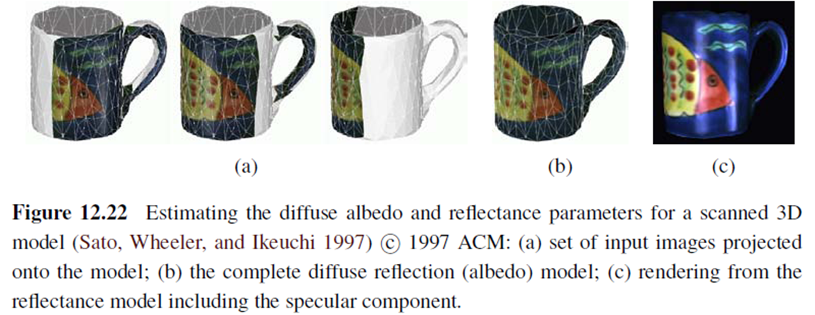
12.7 Recovering Texture Maps and Albedos
After a 3D model of an object or person has been acquired, the final step in modeling is usually to recover a texture map to describe the object’s surface appearance

Slide 95
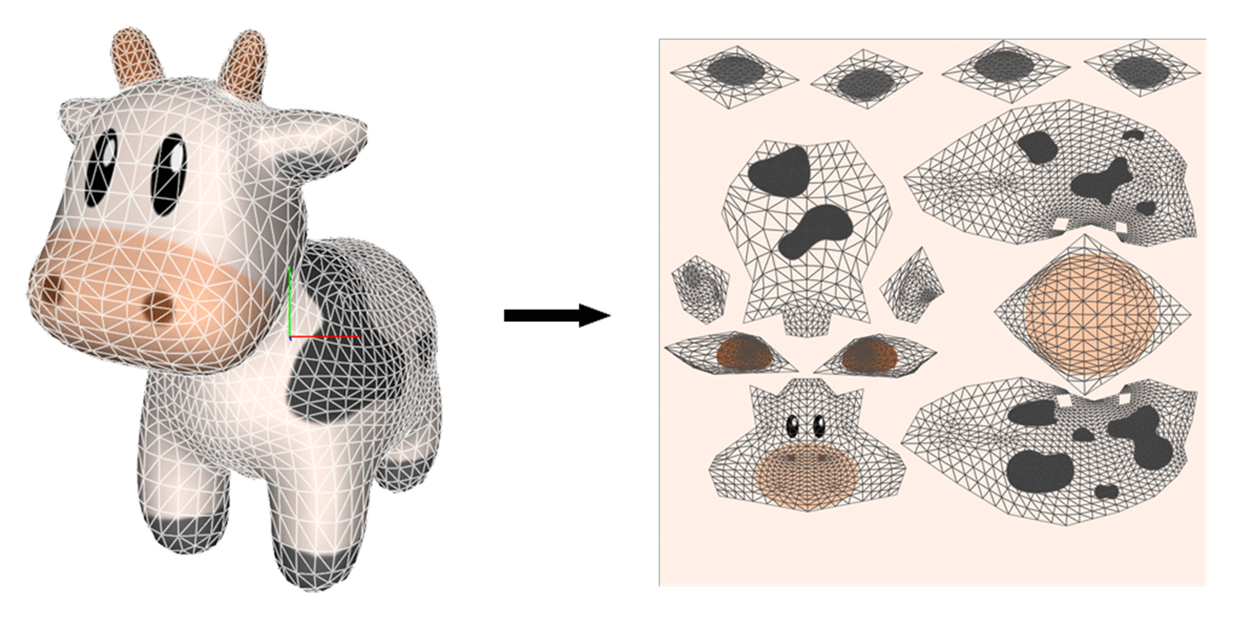
12.7 Recovering Texture Maps and Albedos

Slide 96
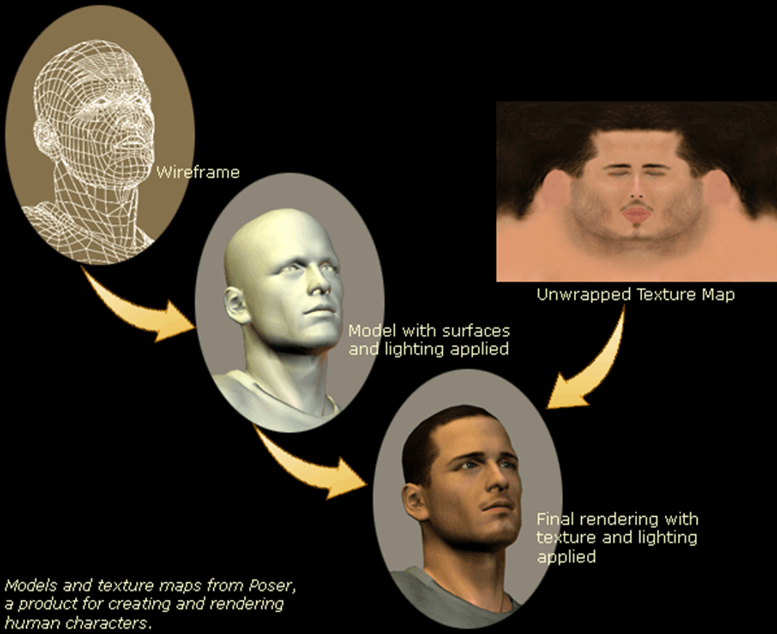
12.7 Recovering Texture Maps and Albedos

Slide 97
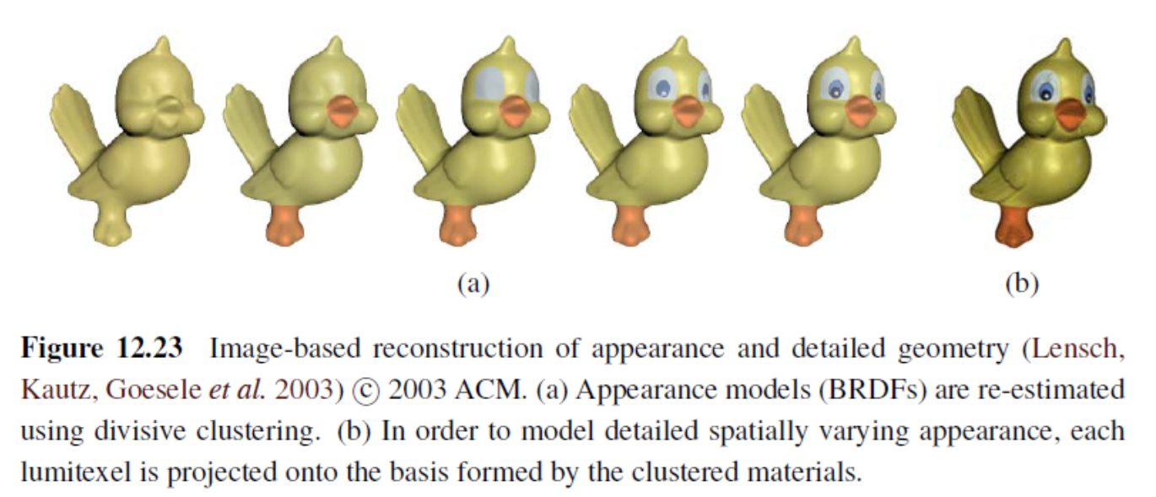
12.7.1 Estimating BRDFs
Notes:
雙向反射分佈函數(bidirectional reflectance distribution function 、BRDF)
1. To build up their models, they first associate a lumitexels, which
contains a 3D position, a surface normal, and a set of sparse radiance samples, with each
surface point.
2. They cluster such lumitexels into materials that share common properties,
using a Lafortune reflectance model (Lafortune, Foo, Torrance et al. 1997) and a divisive
clustering approach (Figure 12.23a).
3.Finally, in order to model detailed spatially varying
appearance, each lumitexel (surface point) is projected onto the basis of clustered appearance
models (Figure 12.23b).

Slide 98
The End!
Q: 為什麼工程師的女友或老婆顏值都普遍高於南方許多？
A: 隨便問十個工程師，九個會說他老婆是新垣結衣

